Slide 1
Project presentation
Devolopment of Parking Management System Usinging C programming
Presented by:
Al Nimra Kabir
2008042
Dept. of Mechatronics Engineering, RUET

Slide 2
Project Name
“Development of Parking Management System Using C Programming”

Slide 3

INTRODUCTION
This project designed to manage the parking of vehicles in a parking lot. It allows users to park a car, show the current status of the parking lot, remove a car, and delete all data and capable to store and display the number of buses, cars, and bikes parked in, as well as the total number of vehicles and the total earnings.

Slide 4
How Does It Works
It has a menu-driven interface that allows the user to select different options. The options include:
Parking a vehicle.
Viewing the status of the parking lot.
Removing a vehicle.
Deleting all data.
Exiting the program.

Slide 5
Parking a Vehicle
When a user selects the option to park a vehicle, they are asked to enter the type of vehicle they want to park, which can be a bus, car, or bike. The program then adds the vehicle to the parking lot and updates the relevant data, such as the number of vehicles, the total earnings, and the number of occupied spaces.

Slide 6
Viewing the status of the parking lot.
When the user selects the option to view the status of the parking lot, the program displays the occupied spaces, the number of buses, cars, bikes, and the total number of vehicles in the parking lot, as well as the total earnings.

Slide 7
Removing a vehicle
When the user selects the option to remove a vehicle, they are asked to enter the space number of the vehicle they want to remove. The program then removes the vehicle from the parking lot and updates the relevant data

Slide 8
Deleting all data
The program resets all data, such as the number of vehicles, the total earnings, and the number of occupied spaces, to zero.

Slide 9
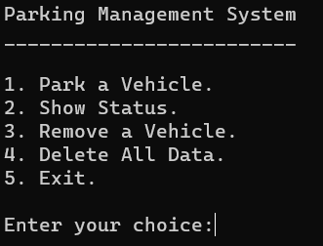
Outputs
Main Menu Interface

Slide 10
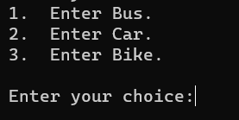
Outputs
Park a Vehicles

Slide 11
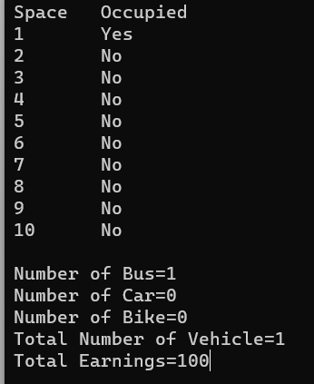
Outputs
Viewing the status of the parking lot

Slide 12

Outputs
Remove a Car

Slide 13
Developments
Graphics
Billing
Graphics could be added to this program for more being more user friendly.
A billing methode couldbe added in this program.

Slide 14
Any Questions?

Slide 15

Thank you

